Slide 1
Data Structures and algorithms SEARCHING

Slide 2
Searching – DATA STRUCTURE
What is Searching?
Searching is the process of finding a given value position in a list of values.
It decides whether a search key is present in the data or not.
It is the algorithmic process of finding a particular item in a collection of items.
It can be done on internal data structure or on external data structure.

Slide 3
Searching – DATA STRUCTURE
Searching Techniques
To search an element in a given array, it can be done in following ways: 1. Sequential Search 2. Binary Search

Slide 4
SEQUENTIAL SEARCH – DATA STRUCTURE
Sequential Search
Sequential search is also called as Linear Search.
Sequential search starts at the beginning of the list and checks every element of the list.
It is a basic and simple search algorithm.
Sequential search compares the element with all the other elements given in the list. If the element is matched, it returns the value index, else it returns -1.

Slide 5
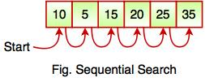
SEQUENTIAL SEARCH – DATA STRUCTURE
The above figure shows how sequential search works. It searches an element or value from an array till the desired element or value is not found. If we search the element 25, it will go step by step in a sequence order. It searches in a sequence order. Sequential search is applied on the unsorted or unordered list when there are fewer elements in a list.

Slide 6
SEQUENTIAL SEARCH – DATA STRUCTURE
int search(int arr[], int n, int x)
{
int i;
for (i = 0; i < n; i++)
if (arr[i] == x)
return i;
return -1;
}
void main(void)
{
int arr[] = { 2, 3, 4, 10, 40 };
int x = 10;
int n = sizeof(arr) / sizeof(arr[0]);
int result = search(arr, n, x);
if (result == -1)
cout << "Element is not present in array";
else
cout << "Element is present at index " << result;
}
Iterative Implementation in C++

Slide 7
BINARY SEARCH – DATA STRUCTURE
Binary Search
Binary Search is used for searching an element in a sorted array.
It is a fast search algorithm with run-time complexity of O(log n).
Binary search works on the principle of divide and conquer.
This searching technique looks for a particular element by comparing the middle most element of the collection.
It is useful when there are large number of elements in an array.

Slide 8

BINARY SEARCH – DATA STRUCTURE
The above array is sorted in ascending order. As we know binary search is applied on sorted lists only for fast searching.

Slide 9
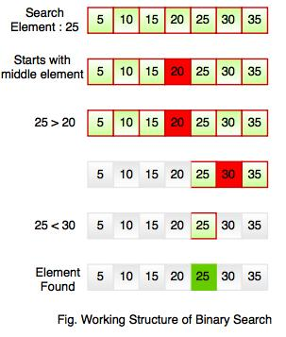
BINARY SEARCH – DATA STRUCTURE
For example, if searching an element 25 in the 7-element array, following figure shows how binary search works:
Binary searching starts with middle element. If the element is equal to the element that we are searching then return true. If the element is less than then move to the right of the list or if the element is greater than then move to the left of the list. Repeat this, till you find an element.
The idea of binary search is to use the information that the array is sorted and reduce the time complexity to O(Log n).

Slide 10
BINARY SEARCH – DATA STRUCTURE
We basically ignore half of the elements just after one comparison.
Compare x with the middle element.
If x matches with middle element, we return the mid index.
Else If x is greater than the mid element, then x can only lie in right half subarray after the mid element. So we recur for right half.
Else (x is smaller) recur for the left half.

Slide 11
BINARY SEARCH – DATA STRUCTURE
Recursive Implementation in C++
int binarySearch(int arr[], int l, int r, int x)
{
if (r >= l) {
int mid = l + (r - l) / 2;
// If the element is present at the middle is itself
if (arr[mid] == x)
return mid;
// If element is smaller than mid, then it can only be present in left subarray
if (arr[mid] > x)
return binarySearch(arr, l, mid - 1, x);
// Else the element can only be present in right subarray
return binarySearch(arr, mid + 1, r, x);
// We reach here when element is not present in array
}
return -1;
}
void main(void)
{
int arr[] = { 2, 3, 4, 10, 40 };
int x = 10;
int n = sizeof(arr) / sizeof(arr[0]);
int result = binarySearch(arr, 0, n - 1, x);
(result == -1) ? cout << "Element is not present in array" : cout << "Element is present at index " << result;
}

Slide 12
BINARY SEARCH – DATA STRUCTURE
Iterative Implementation in C++
int binarySearch(int arr[], int l, int r, int x)
{
while (l <= r) {
int m = l + (r - l) / 2;
// Check if x is present at mid
if (arr[m] == x)
return m;
// If x greater, ignore left half
if (arr[m] < x)
l = m + 1;
// If x is smaller, ignore right half
else
r = m - 1;
}
// if we reach here, then element was not present
return -1;
}
void main(void)
{
int arr[] = { 2, 3, 4, 10, 40 };
int x = 10;
int n = sizeof(arr) / sizeof(arr[0]);
int result = binarySearch(arr, 0, n - 1, x);
(result == -1) ? cout << "Element is not present in array"
: cout << "Element is present at index " << result;
}

Slide 13
BINARY SEARCH – DATA STRUCTURE
Linear Search vs Binary Search
A linear search scans one item at a time, without jumping to any item .
The worst case complexity is O(n), sometimes known an O(n) search
Time taken to search elements keep increasing as the number of elements are increased.
A binary search however, cut down your search to half as soon as you find middle of a sorted list.
The middle element is looked to check if it is greater than or less than the value to be searched.
Accordingly, search is done to either half of the given list

Slide 14
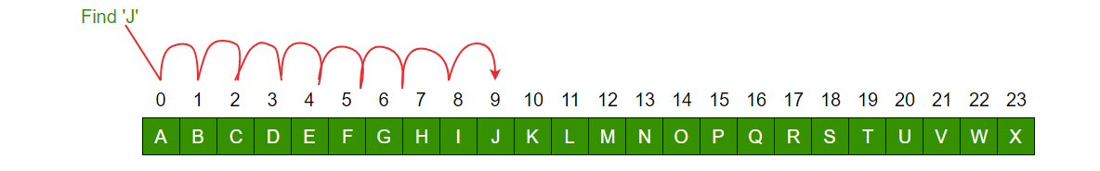
BINARY SEARCH – DATA STRUCTURE
Important Differences
Input data needs to be sorted in Binary Search and not in Linear Search
Linear search does the sequential access whereas Binary search access data randomly.
Time complexity of linear search -O(n) , Binary search has time complexity O(log n).
Linear search performs equality comparisons and Binary search performs ordering comparisons
Let us look at an example to compare the two:
Linear Search to find the element “J” in a given sorted list from A-X

Slide 15
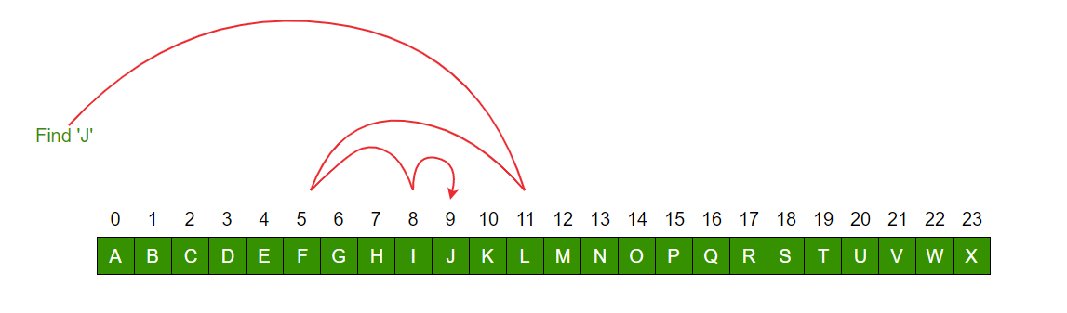
BINARY SEARCH – DATA STRUCTURE

